Slide 1
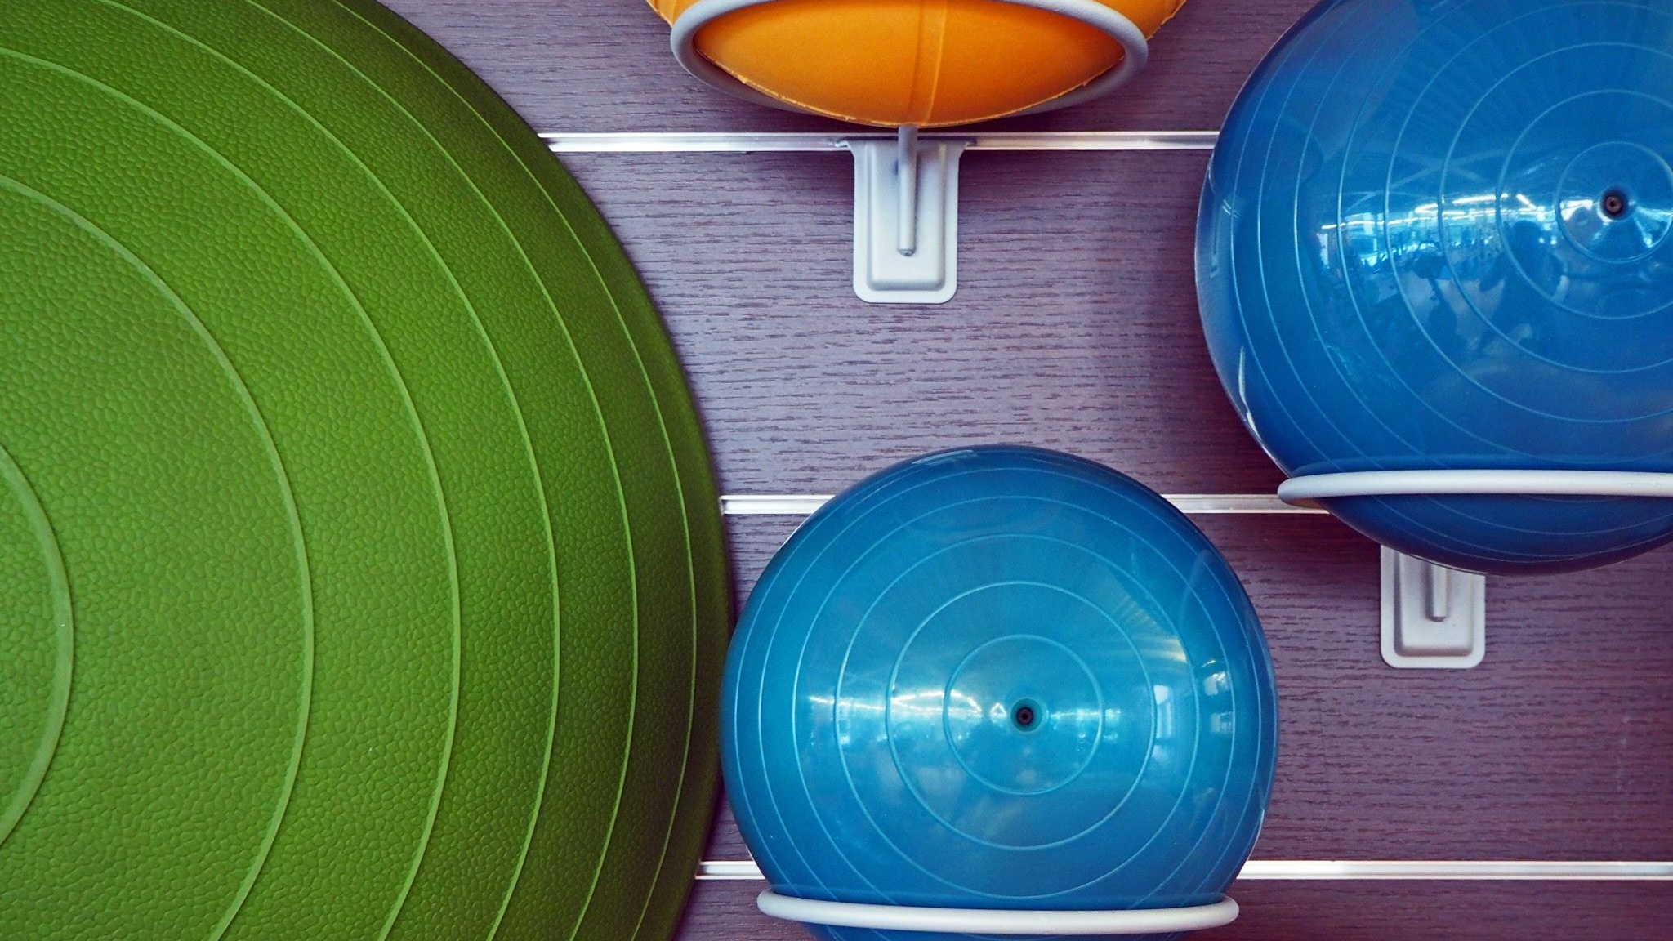
Pool Simulator
Dovydas Simkus, Bogdan sergijenko, ostin mathias, chris kerr

Slide 2
Basic Overview
There will be circles moving due to a motion inputted by the user.
The circles will bounce of one another due to physics (kinetic transfer of motion).
The circles will give points when they hit 1 of the 6 holes at the edges of the screen, the game will end when the black circle goes into the hole.
More points will be awarded depending on whether the circles are potted in the holes in one “turn”.

Slide 3
Game Design
There are 4 main areas of focus for the program, where all inputs and outputs will be in the rational number set (Q).
Collision
Ball
Cue
Table

Slide 4
Collision
This will be the biggest part where all the calculations will have to be made.
It will detect every frame if there is any collisions.
If there are, it will run a calculation for both balls and react accordingly with the correct angle and velocity.
There also will be a collision for the pots at the table sides, so that the balls will disappear.
The table edges will also bounce the balls away from them.
This satisfies

Slide 5
Cue
The cue will appear on the white ball, to show the user where they are going to shoot the ball and how much power they will give the ball.
It will appear only when all the balls are stationary.
It will go up and down a power scale.

Slide 6
Ball
The ball class will store functions to help with movement (such as coordinates and velocity), but will also have a function to change the velocity and direction of the ball as well.
This satisfies the projectile motion aspect of the project.

Slide 7
Table
The table will have edges where the balls will collide with and will have holes which will be where the user will try to shoot the balls to.
When the balls are pot in the holes, it will give a score of some number of points (100), which increases by more if there are multiple balls pot during one strike.
This satisfies the scoring system aspect of the project.

Slide 8
Simulations

Slide 9
The END

